Slide 1
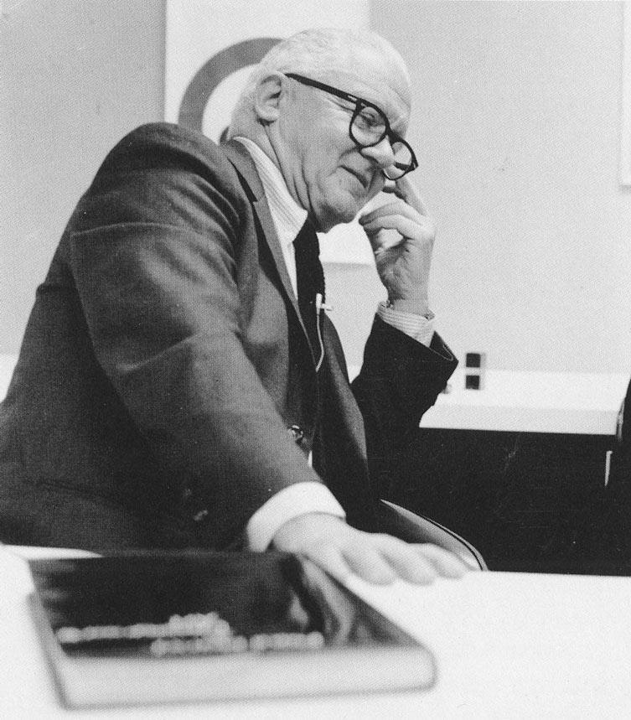
PAUL RAND
Graphic Designer
August 15, 1914 in Brooklyn, New York.

Slide 2
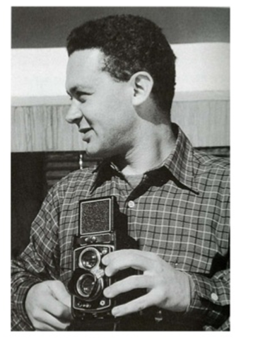
Paul Rand
He embraced design at a very young age, painting signs for his father's grocery store as well as for school events.
Rand's father did not believe art could provide his son with a sufficient livelihood, and so he required Paul to attend Manhattan's HARREN HIGH SCHOOL while taking night classes at the PRATT INSTITUTE.

Slide 3
Paul Rand
Rand was largely "self-taught“ as a designer.

Slide 5
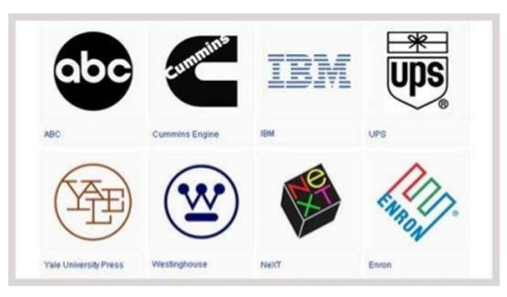
LOGOS:
Paul Rand was an American art director and graphic designer, best known for his corporate logo designs, including the logos for IBM, UPS, Enron, Morningstar, Inc., Westinghouse, ABC, and NeXT.

Slide 7
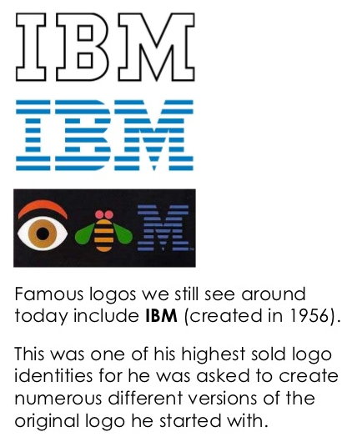

Slide 8
United Parcel Service (UPS)

Slide 9
ABC

Slide 10
Cummins 1962

Slide 12
Harcourt Brace and Company 1957

Slide 14
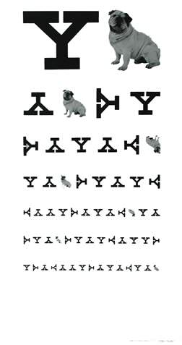
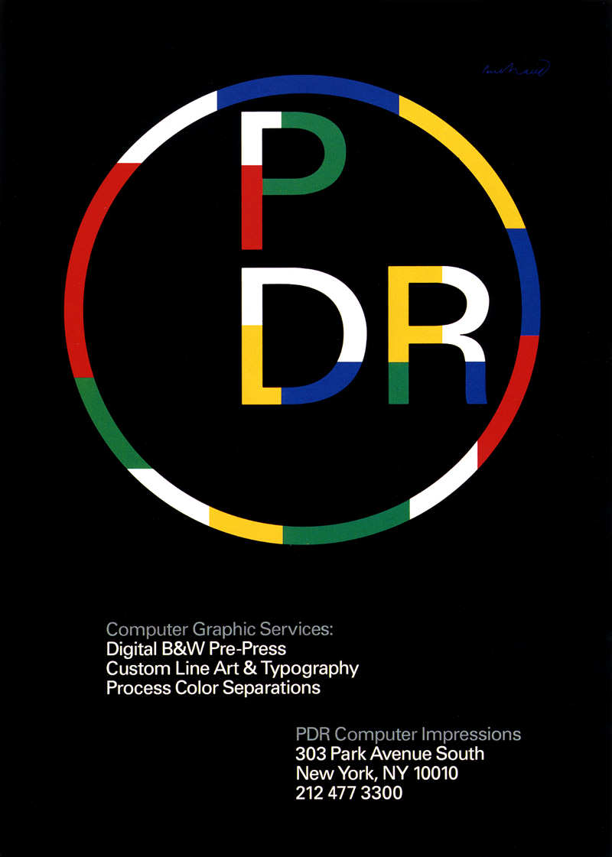
1987
Yale Eye Chart
1985

Slide 15
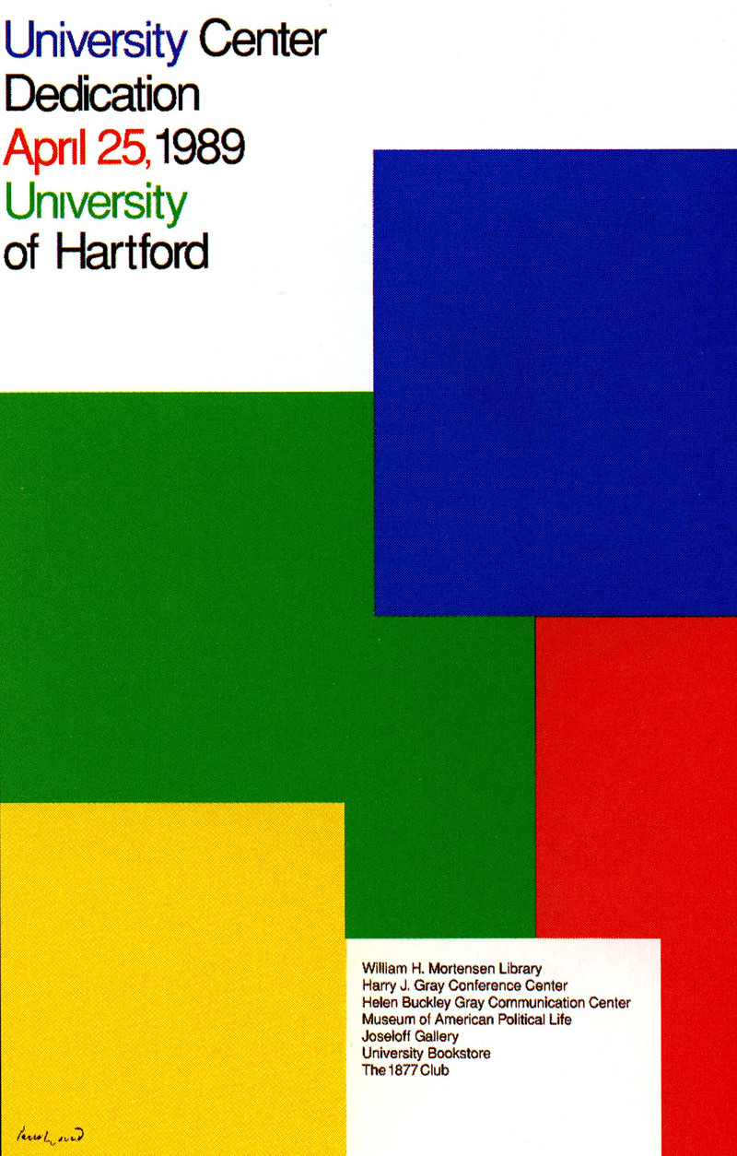

Slide 16
1989

Slide 17
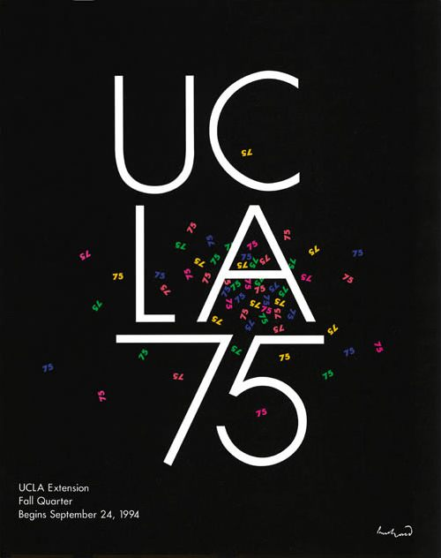

Slide 19
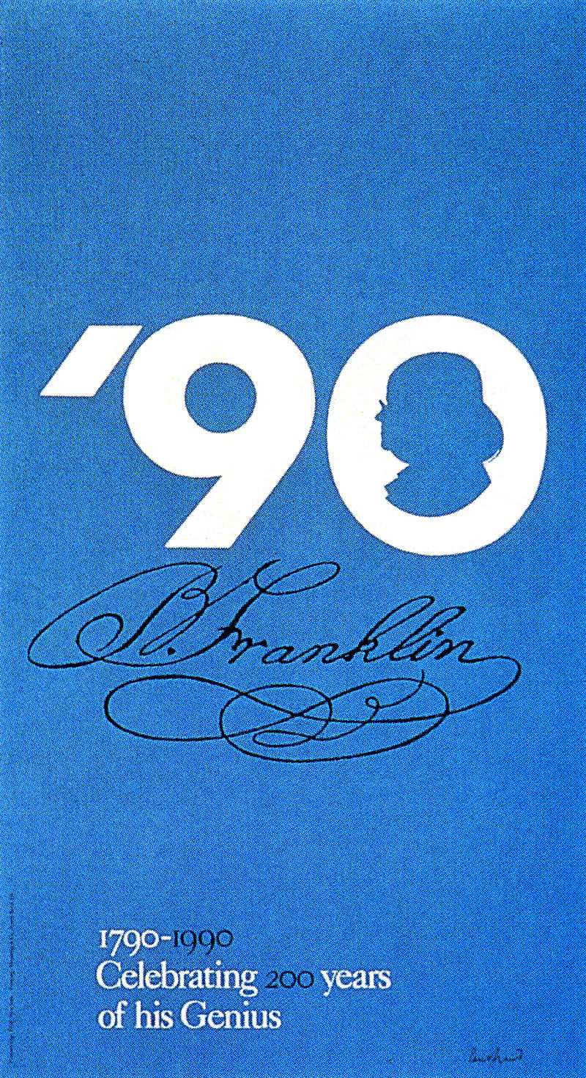
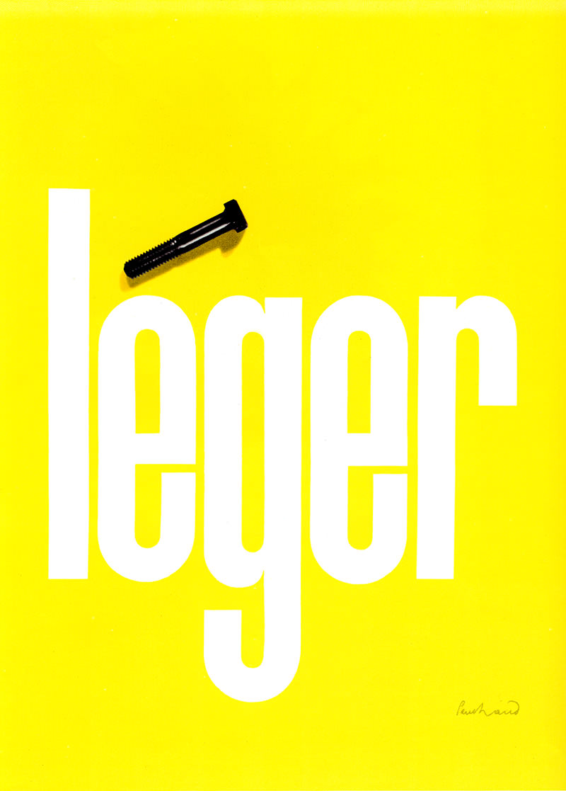
Leger collage
1988

Slide 20
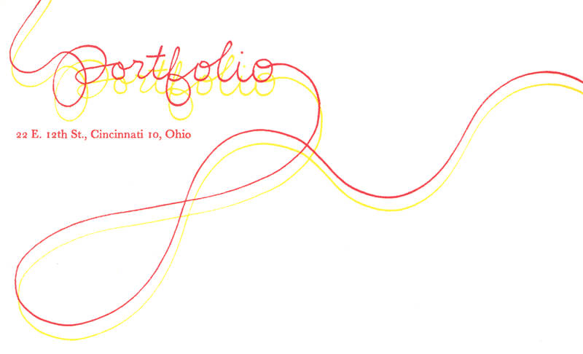
Magazine Cover:
Portfolio Magazine
Logotype 1940s
In 1936, Rand was given the job of setting the page layout for an Apparal Art (now GQ) magazine anniversary issue. "His remarkable talent for transforming routine photographs into dynamic compositions, which gave editorial weight to the page" earned Rand a full-time job, as well as an offer to take over as art director for the ESQUIRE-CORONET magazines.

Slide 21
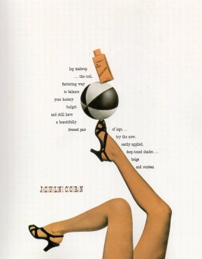
Jacqueline Cochran ad from the early ’40s shows Rand’s approach to combining
COURTESY OF MUSEUM OF CITY OF NY/STEVEN HELLER

Slide 22
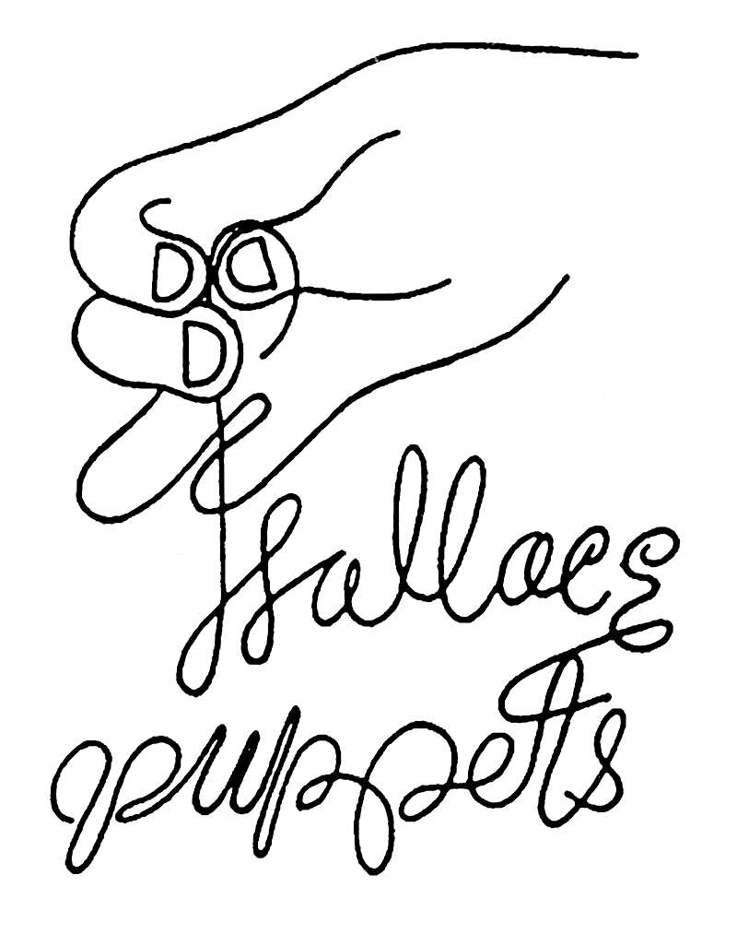
Esquire Magazine
1938
Wallace Puppets
1938

Slide 23
Packaging
Cummins

Slide 24
Packaging
Cummins

Slide 25
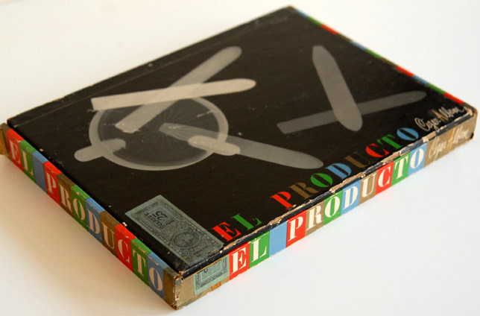
Packaging
El Producto Cigar box

Slide 26
Packaging
El Producto Cigar box

Slide 27
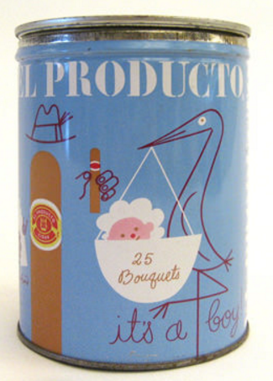
Packaging
El Producto cigar cans

Slide 28
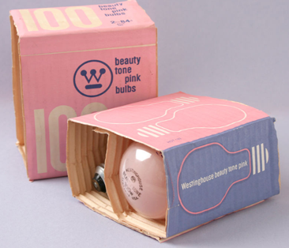
Westinghouse
Packaging

Slide 29
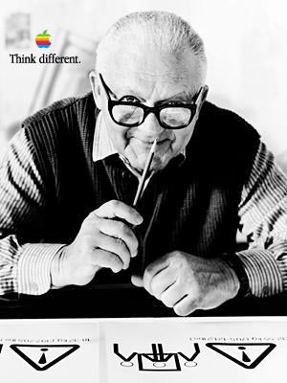
Later Years:
Rand devoted his final years to design work and the writing of his memoirs.
In 1996, he died of cancer at age 82 in Norwalk, Connecticut. He is buried in Beth El Cemetery.

